Slide 1
BINARY SEARCH ALGORITHM
Pseudocode
University of Essex
Launching into Computer Science
Seminar 4
Alice Villar
Professor Dr. Nawaz Khan

Slide 2

The binary search algorithm is more efficient than the linear search
algorithm because it takes less time to search through the list.
How does it work?
A binary search works by finding the middle element of a sorted array and comparing it to your target element.
Requirement:
The array must be sorted first to be able to apply binary search. Ex.: bubble sort, quick sort, merge sort.

Slide 3
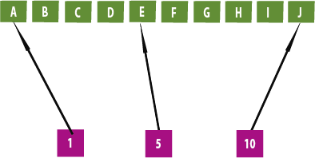
Basic Steps:
Step 1 - Read the search element from the user.
Step 2 - Find the middle element in the sorted list.
How? Sum the number of the first position with the last position and do an integer division.
Step 3 - Compare the search element with the middle element in the sorted list.
Step 4 - If both are matched, then display "Element found!!" and terminate the function.
Step 5 - If both are not matched, then check whether the search element is smaller or larger than the middle element.
Step 6 - If the search element is smaller than middle element, repeat the same process for the left sublist of the middle element.
Step 7 - If the search element is larger than middle element, repeat the same process for the right sublist of the middle element.
Step 8 - Repeat the same process until we find the search element in the list or until sublist contains only one element.
Step 9 - If that element also doesn't match with the search element, then display "Element is not found in the list!!" and terminate the function.
(10+1) //2 = 5

Slide 4
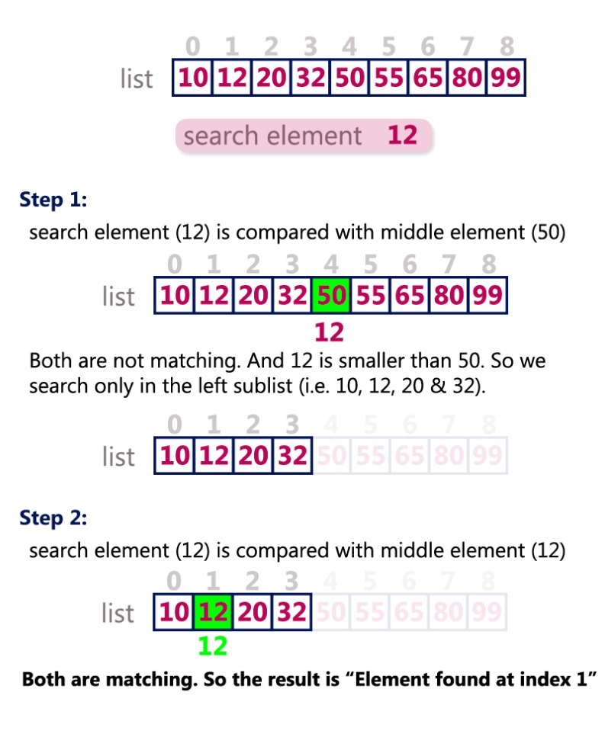
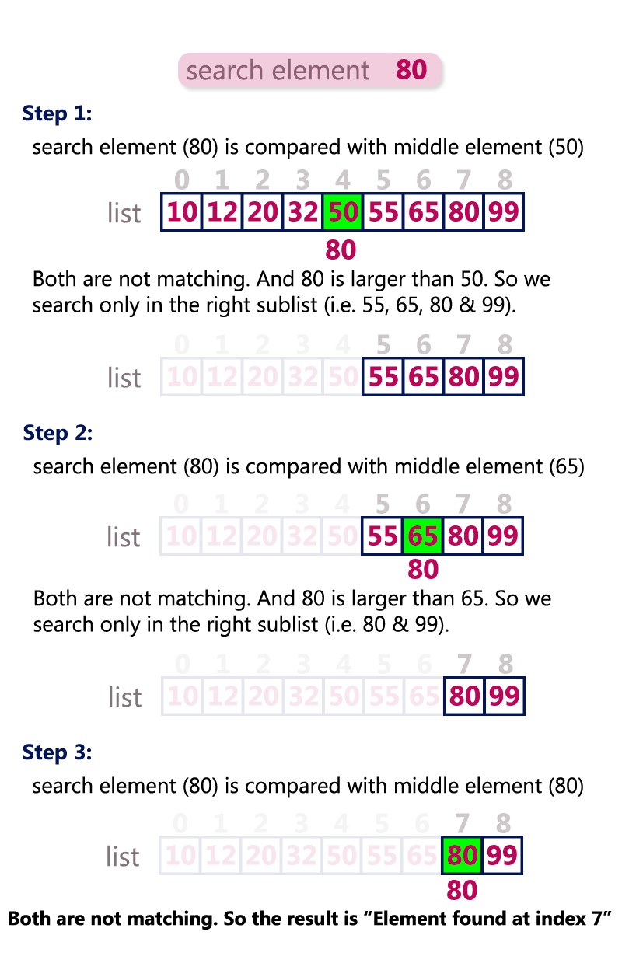
Reference:
Data Structures - Binary Search Algorithm
http://www.btechsmartclass.com/data_structures/binary-search.html

Slide 5
